Slide 1



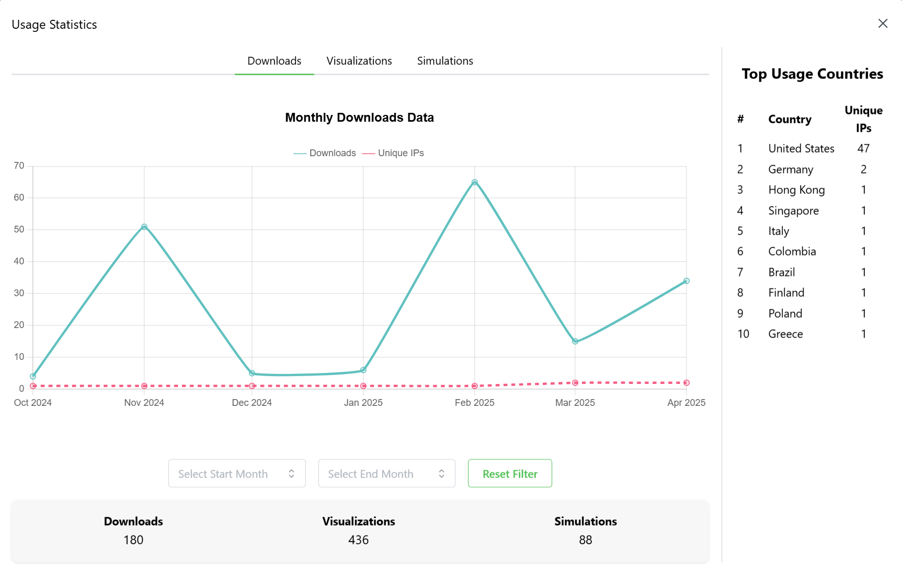
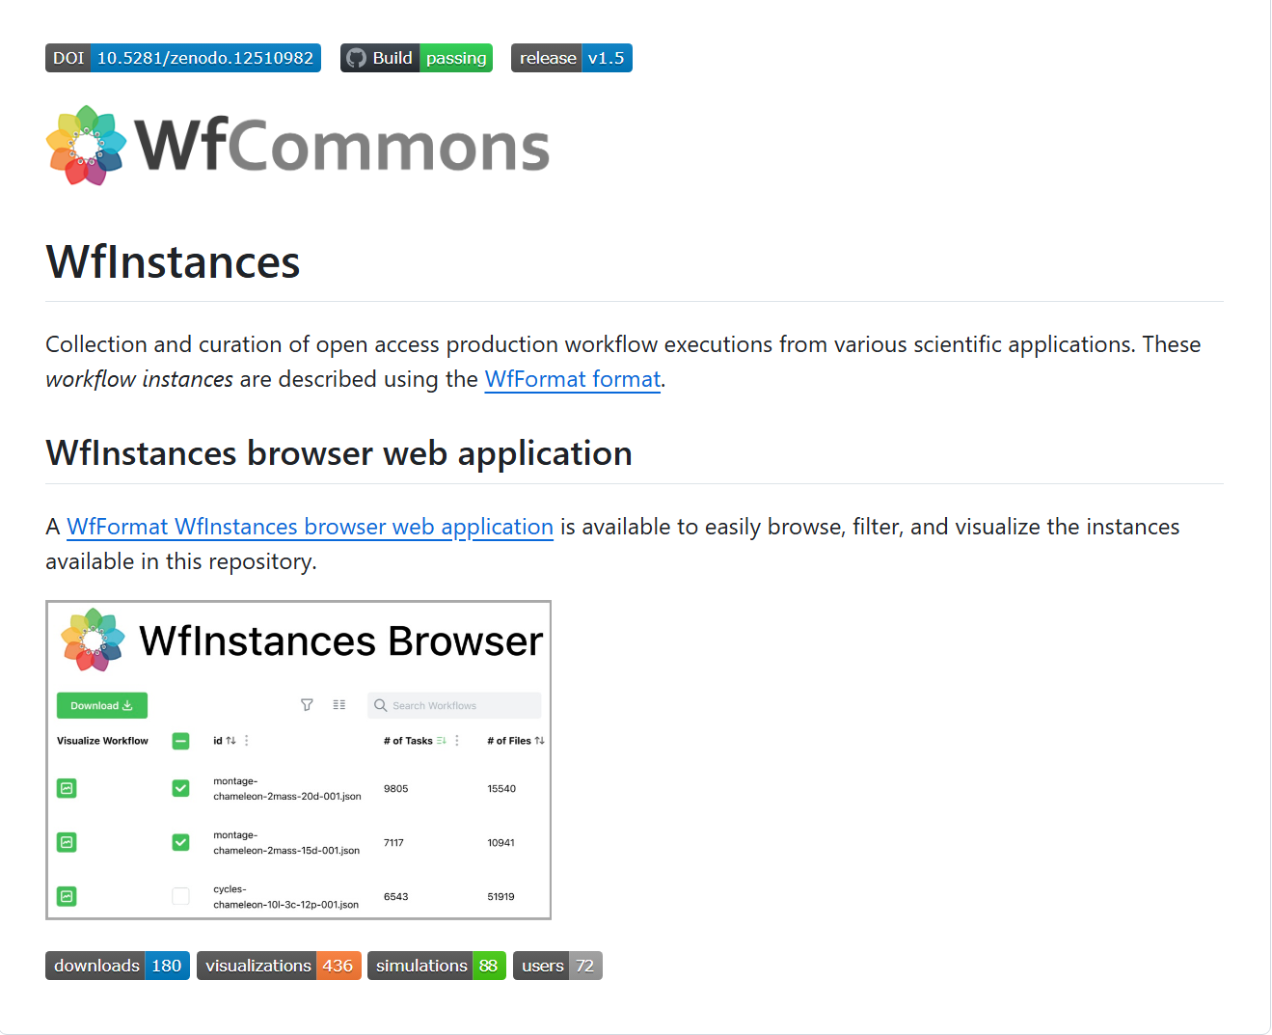
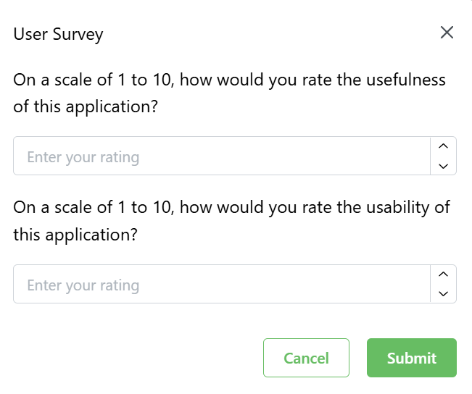

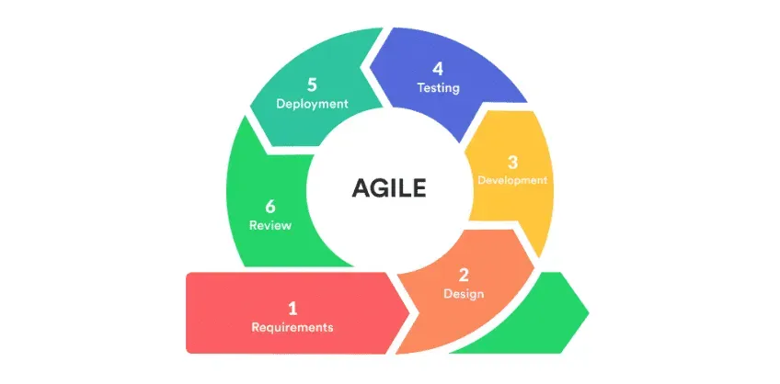
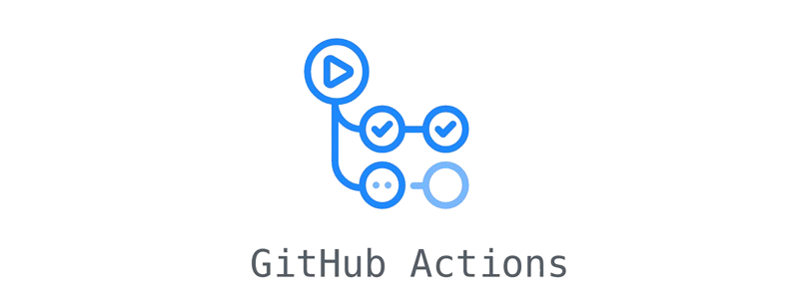




WfInstances Browser
Jianlong Chen, Kenneth de Guzman
University of Hawaii at Mānoa - Information and Computer Sciences Department
Sponsor: Henri Casanova | UH Mānoa
ICS 496
Spring 2025
Background
In scientific domains, workflows are the blueprints for complex computational processes for data processing and analysis.
The WfCommons project hosts are repository of production workflow instances, WfInstances. These instances support a wide range of research, development, and education activities.
The WfInstances Browser is an accompanying web application that lets users easily browse, select, sort, download, simulate, visualize workflow instances in WfCommons repositories.
Objectives
Add new features to the existing WfInstances Browser implementation to increase usability
Update the WfInstances GitHub repository to dynamically display WfInstances Browser usage metrics
Add user questionnaires to gather and archive feedback
Improve the way in which the WfInstances Browser acquires workflow instances from the WfInstances repository
Methodology
Project Management
Weekly Meetings with team and sponsor to ensure best practices and following proper next steps
Agile Project Management using GitHub projects as Kanban Board for Issue Driven Project Management (IDPM)
Assigning Roles at project kickoff to determine members’ responsibilities for evenly distributed work throughout project
Challenges
Gaining familiarity with working with Docker deployments and backend development
Ensuring that the data flow between the frontend and the backend is both correct and efficient
Learning to work with the backend REST API, especially for
Routing the backend data all the way to the modal component in the frontend
Implementing IPInfo geolocation tracking
Accomplishments
Implementation of New Features in the WfInstances Browser
Added a modal that shows timeline and aggregate usage reports for downloads, simulations, and visualizations
Date ranges can be customized for filtering usage data
Users’ countries of origin are displayed in a sidebar using IP geolocation tracking
Users are occasionally prompted with questionnaires about usability and usefulness of the app
Worfklow instances are now acquired using the git Python package instead of the GitHub REST API, for higher performance
A GitHub action was added to the WfInstances repository to display WfInstances Browser usage data
Takeaways
Increased proficiency using Python for backend and TypeScript for frontend development
First hands-on experience with developing a GitHub action
Gained more knowledge about software development in general using many different technologies
Outcome
All deployed in production at: https://wfinstances.ics.hawaii.edu
Technologies Used
Contact
Team: Jianlong Chen, Kenneth de Guzman
Email: jianlong@hawaii.edu, kdeguz@hawaii.edu
Website: https://wfinstances.github.io/

